Slide 1
Wildfire Data Analysis & Visualization
By team 1 ( Abdullatif & Ben )

Slide 2
Outlines
1- Overview and Datasets
2- Exploratory Data Analysis (EDA)
2- Data Modeling
3- Model Evaluation
4- Visualization
Spatial Gaussian Process Regression Model
Non-Gaussian Spatio-Temporal Model - GAM

Slide 3
Overview and Datasets
Objective: The problem our team is trying to solve is how can we visualize and analyze spatially the spread of wildfires in the US and specifically the state of Texas.
1- Wildland_Fire_Locations_US
From: National Interagency Fire Center
Link: https://data-nifc.opendata.arcgis.com
Period: April,2009 - Sep,2022
2- Texas_Fire_Department_and_Substations
From: Texas A&M Forest Service
Link: https://public.tfswildfires.com
Notes:
The objective of our project is …..

Slide 4
Exploratory Data Analysis (EDA)
Data Preparation (Data cleansing and imputation)
Removing duplicates
Filtering unwanted outliers
Selecting specific features
Splitting / Rename columns
Changing data types
Handling missing data

Slide 5
Exploratory Data Analysis (EDA)
Data Preparation (Data cleansing and imputation)
1- Wildland_Fire_Locations_US
# of data points : 136,868
2- Texas_Fire_Department_and_Substations
# of data points : 3189
Longitude | Latitude | FireCause | County | FireDiscoveryDate
FireDiscoveryTime | FireOutDate | FireOutTime | State
FireDepartmentName | SubstationName/PhysicalCity | County | Latitude | Longitude

Slide 6
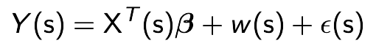
Data Modeling (First Model)
Spatial Gaussian Regression Model
:
Time spent to put out the fire (days) at location s
:
Spatial random effect
:
Coordination (Lon,Lat) at location s
:
Random noise
:
Coefficients need to be estimated
Notes:
W(s) : to quantify the spatial dependence that is unexplained by the covariants
The objective: To predict how much time the fire will last in a specific location (S)

Slide 7
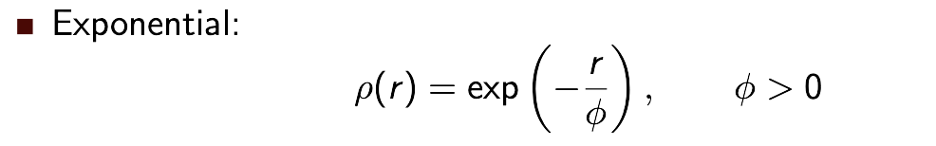
Data Modeling (First Model)
:
Spatial random effect
Gaussian Process with mean = 0 and covariance = 𝝈^2 * 𝙥 (r) where 0 < 𝙥 (r) < 1
We will estimate 𝝈^2 : applying a simple linear regression model (fit.lm) not considering the data as a spatial data and take the variance of the output
We will estimate 𝙥 (r): applying exponential covariance function with the following parameters:
r = The distance between two locations
𝜙 = Spatial range parameter estimated as (the maximum of distance matrix / 3 * 2)
Notes:
This is the most important part of the model because this function will decide if there is a spatial dependence between two locations or not
Phi = to control how fast the function will decline from 1 to 0
So , for example here when we take distance between two locations to be very high … the covariance function will be close to 0 then the covariance will be also close to zero that means that there is no spatial dependence between the two locations

Slide 8
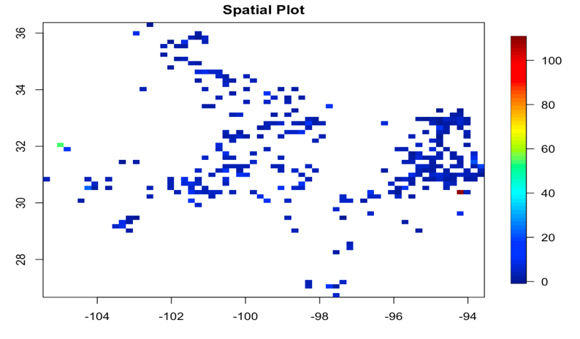
Data Modeling (First Model)
Dataset : Natural fire – Texas
Total observations: 530
80% training and 20% testing
Notes:
This is the most important part of the model because this function will decide if there is a spatial dependence between two locations or not
Phi = to control how fast the function will decline from 1 to 0
So , for example here when we take distance between two locations to be very high … the covariance function will be close to 0 then the covariance will be also close to zero that means that there is no spatial dependence between the two locations

Slide 9
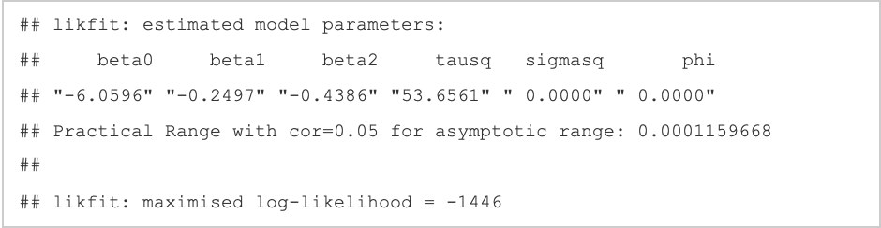
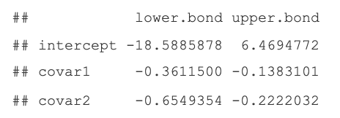
Model Evaluation (First Model)
fit_mle <- likfit(data=Y.train,coords=coords.train,
trend = ~ X.train[,1]+X.train[,2],
fix.nugget=F,cov.model="exponential",ini = c(ini.sigma.sq,ini.phi))
Notes:
This is the most important part of the model because this function will decide if there is a spatial dependence between two locations or not
Phi = to control how fast the function will decline from 1 to 0
So , for example here when we take distance between two locations to be very high … the covariance function will be close to 0 then the covariance will be also close to zero that means that there is no spatial dependence between the two locations

Slide 10
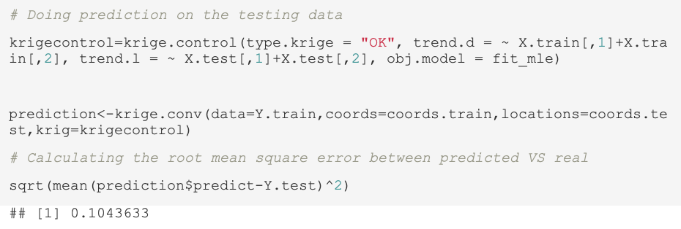
Model Evaluation (First Model)
Notes:
This is the most important part of the model because this function will decide if there is a spatial dependence between two locations or not
Phi = to control how fast the function will decline from 1 to 0
So , for example here when we take distance between two locations to be very high … the covariance function will be close to 0 then the covariance will be also close to zero that means that there is no spatial dependence between the two locations

Slide 11

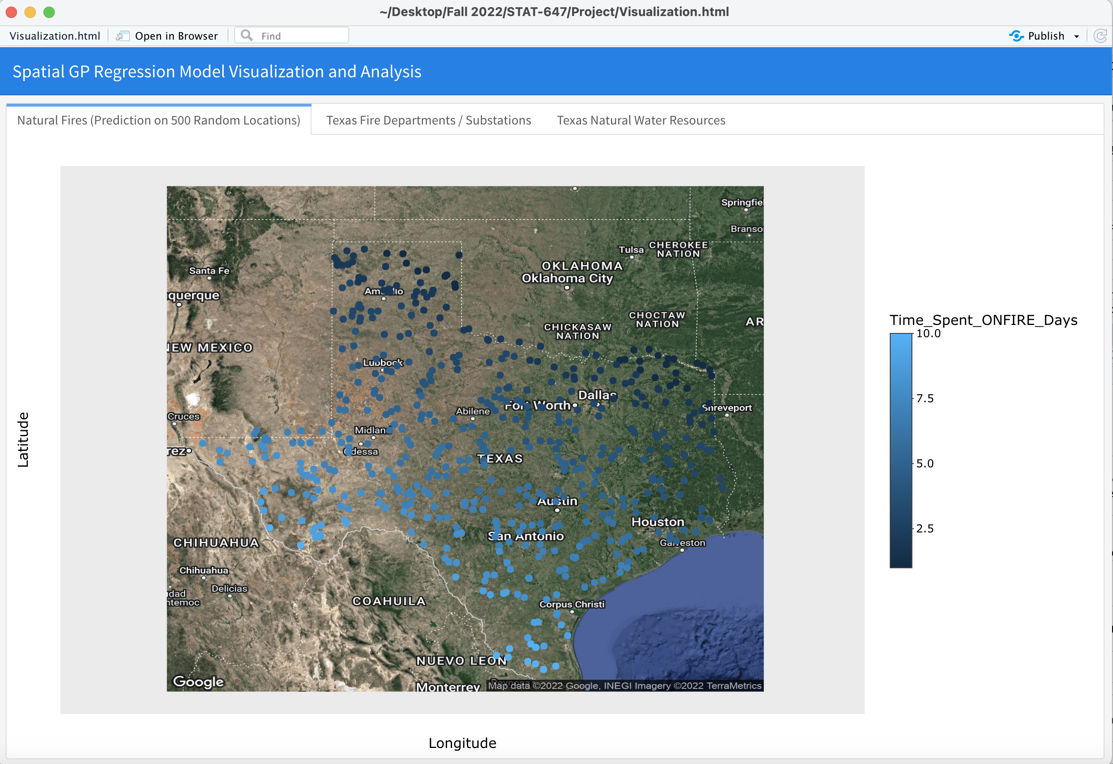
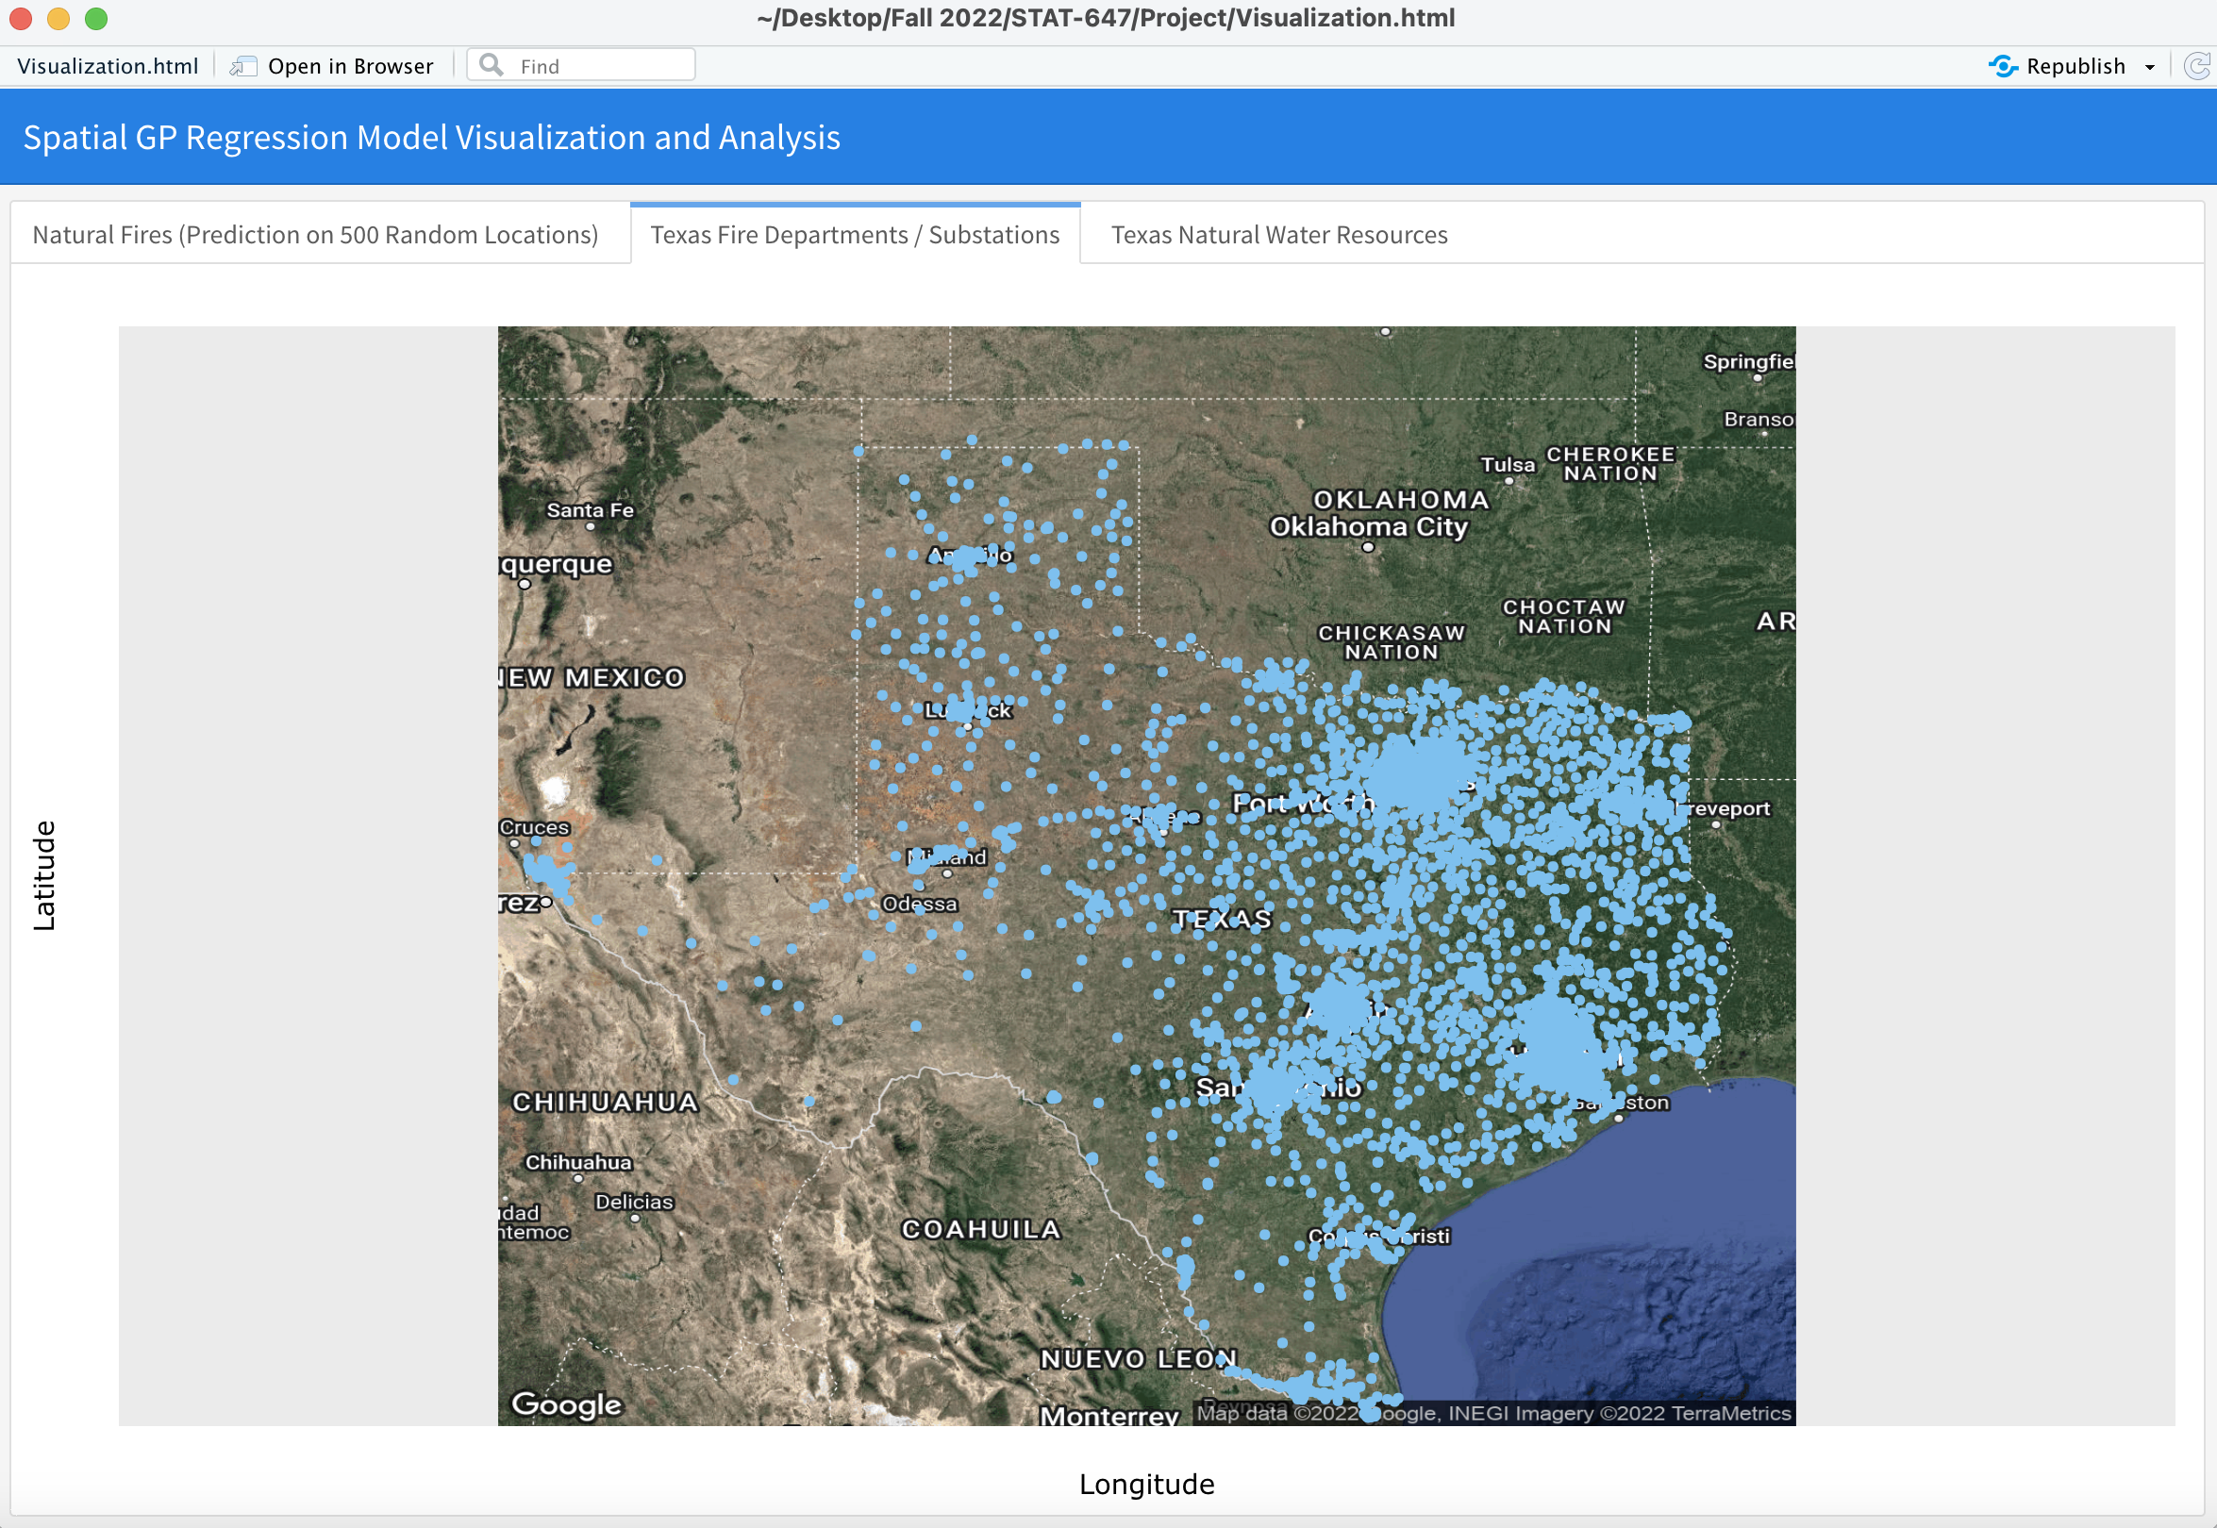
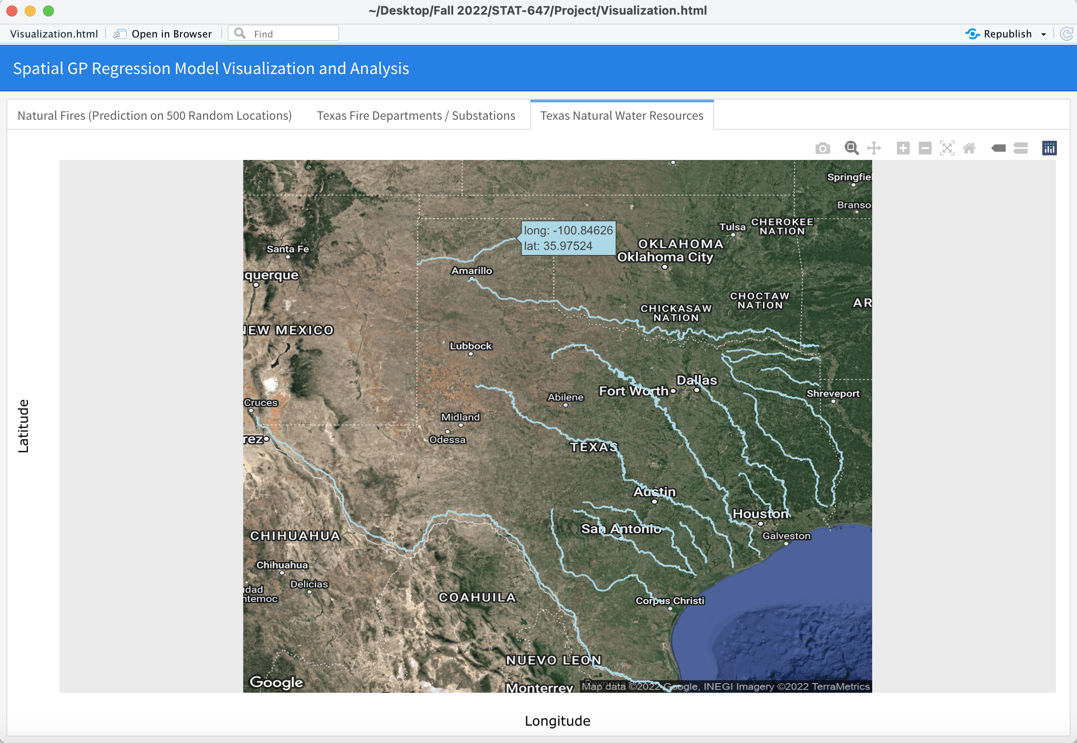
Visualization (First Model)
We used “flexdashboard” to visualize the results :
https://rpubs.com/alnuaimi107/Wildfire_project

Slide 12
GAM - Generalized Additive Model
Second Model

Slide 13
Data Modeling (GAM Model)
Decided on a Non-Gaussian Spatio-Temporal Model for Prediction.
We create this using a Generalized Additive Model (GAM) in R
These are similar to GLMs but have additive components: (smoothing functions (splines) of the covariates (Lon, Lat, Time).
The data is shaped as Negative-Binomial for usage in the GAM model.
Notes:
W(s) : to quantify if there is a spatial dependence between two locations
The objective: To predict how much time the fire will last in a specific location (S)

Slide 14
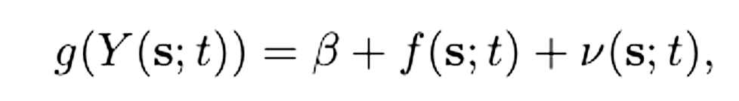
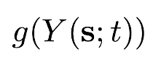
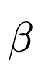
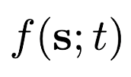
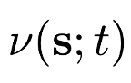
Data Modeling (GAM Model)
General Additive Model (GAM)
Prediction link function for Longitude, Latitude, and Time (Both YRs and Months) - The Response Y is Time Spent Extinguishing the Fire
Spatio-Temporal Intercept
Smoothing function for Splines in terms of covariates for Longitude, Latitude, and Time (space and time)
Spatio-Temporal Random Effect
Notes:
This is the most important part of the model because this function will decide if there is a spatial dependence between two locations or not
Phi = to control how fast the function will decline from 1 to 0
So , for example here when we take distance between two locations to be very high … the covariance function will be close to 0 then the covariance will be also close to zero that means that there is no spatial dependence between the two locations

Slide 15
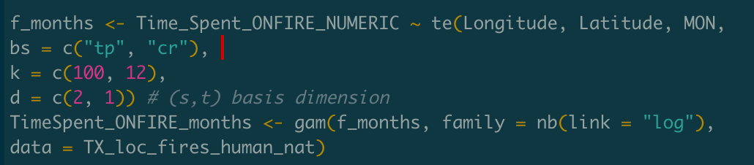
Data Modeling (GAM Model)
Ultimately, we want to see if we can recreate heatplot trends for our data and get general (not exact) predictions with minimal prediction error.
Same process is used for Months and Years as the Time covariate in the model. We want to see a visual representation of these predictions
nb(link = “log”) used to show natural order of predictions more accurately without over-dispersion.
Notes:
This is the most important part of the model because this function will decide if there is a spatial dependence between two locations or not
Phi = to control how fast the function will decline from 1 to 0
So , for example here when we take distance between two locations to be very high … the covariance function will be close to 0 then the covariance will be also close to zero that means that there is no spatial dependence between the two locations

Slide 16
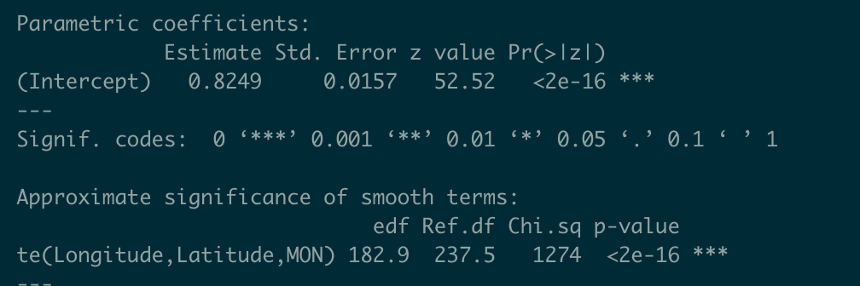
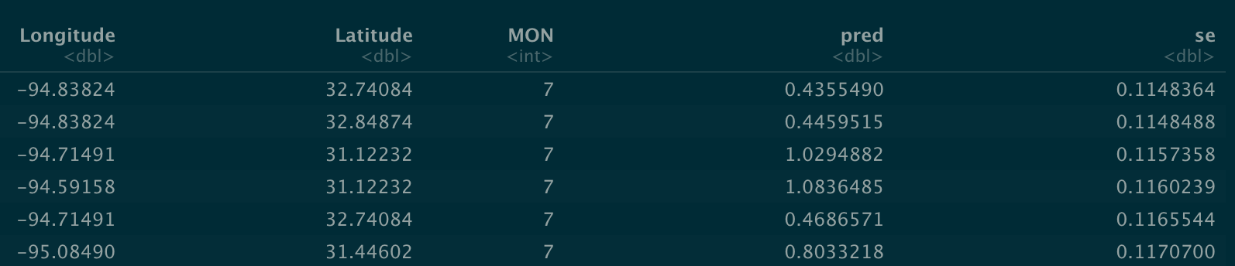
Model Evaluation (GAM Model)
Notes:
This is the most important part of the model because this function will decide if there is a spatial dependence between two locations or not
Phi = to control how fast the function will decline from 1 to 0
So , for example here when we take distance between two locations to be very high … the covariance function will be close to 0 then the covariance will be also close to zero that means that there is no spatial dependence between the two locations

Slide 17
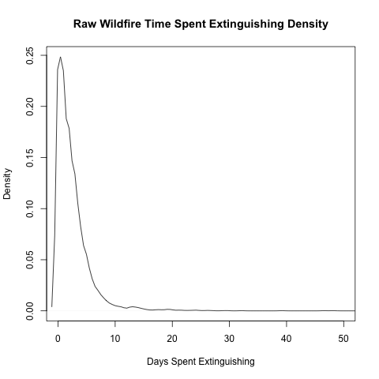
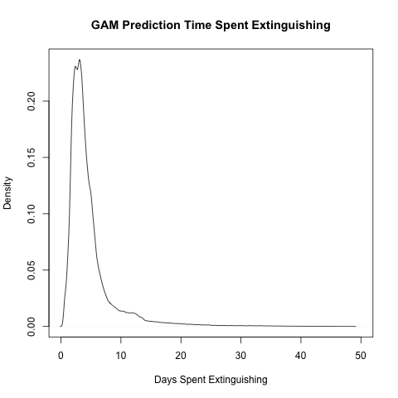
Prediction Steps
Observe densities for both raw data and prediction data to see similar distributions, which means we are on the right track
Notes:
This is the most important part of the model because this function will decide if there is a spatial dependence between two locations or not
Phi = to control how fast the function will decline from 1 to 0
So , for example here when we take distance between two locations to be very high … the covariance function will be close to 0 then the covariance will be also close to zero that means that there is no spatial dependence between the two locations

Slide 18
Visualization (Second Model)
4 plots split into Years (2014 - 2022) and Months (1 - 12) for prediction and prediction standard error.
Prediction standard error can be judged by the dark outline of Texas seen sequentially. The darker the outline, the closer our prediction error is to 0.
Initial Time Plots provided as well.
https://rpubs.com/BKlein1812/981296
Notes:
This is the most important part of the model because this function will decide if there is a spatial dependence between two locations or not
Phi = to control how fast the function will decline from 1 to 0
So , for example here when we take distance between two locations to be very high … the covariance function will be close to 0 then the covariance will be also close to zero that means that there is no spatial dependence between the two locations

Slide 19
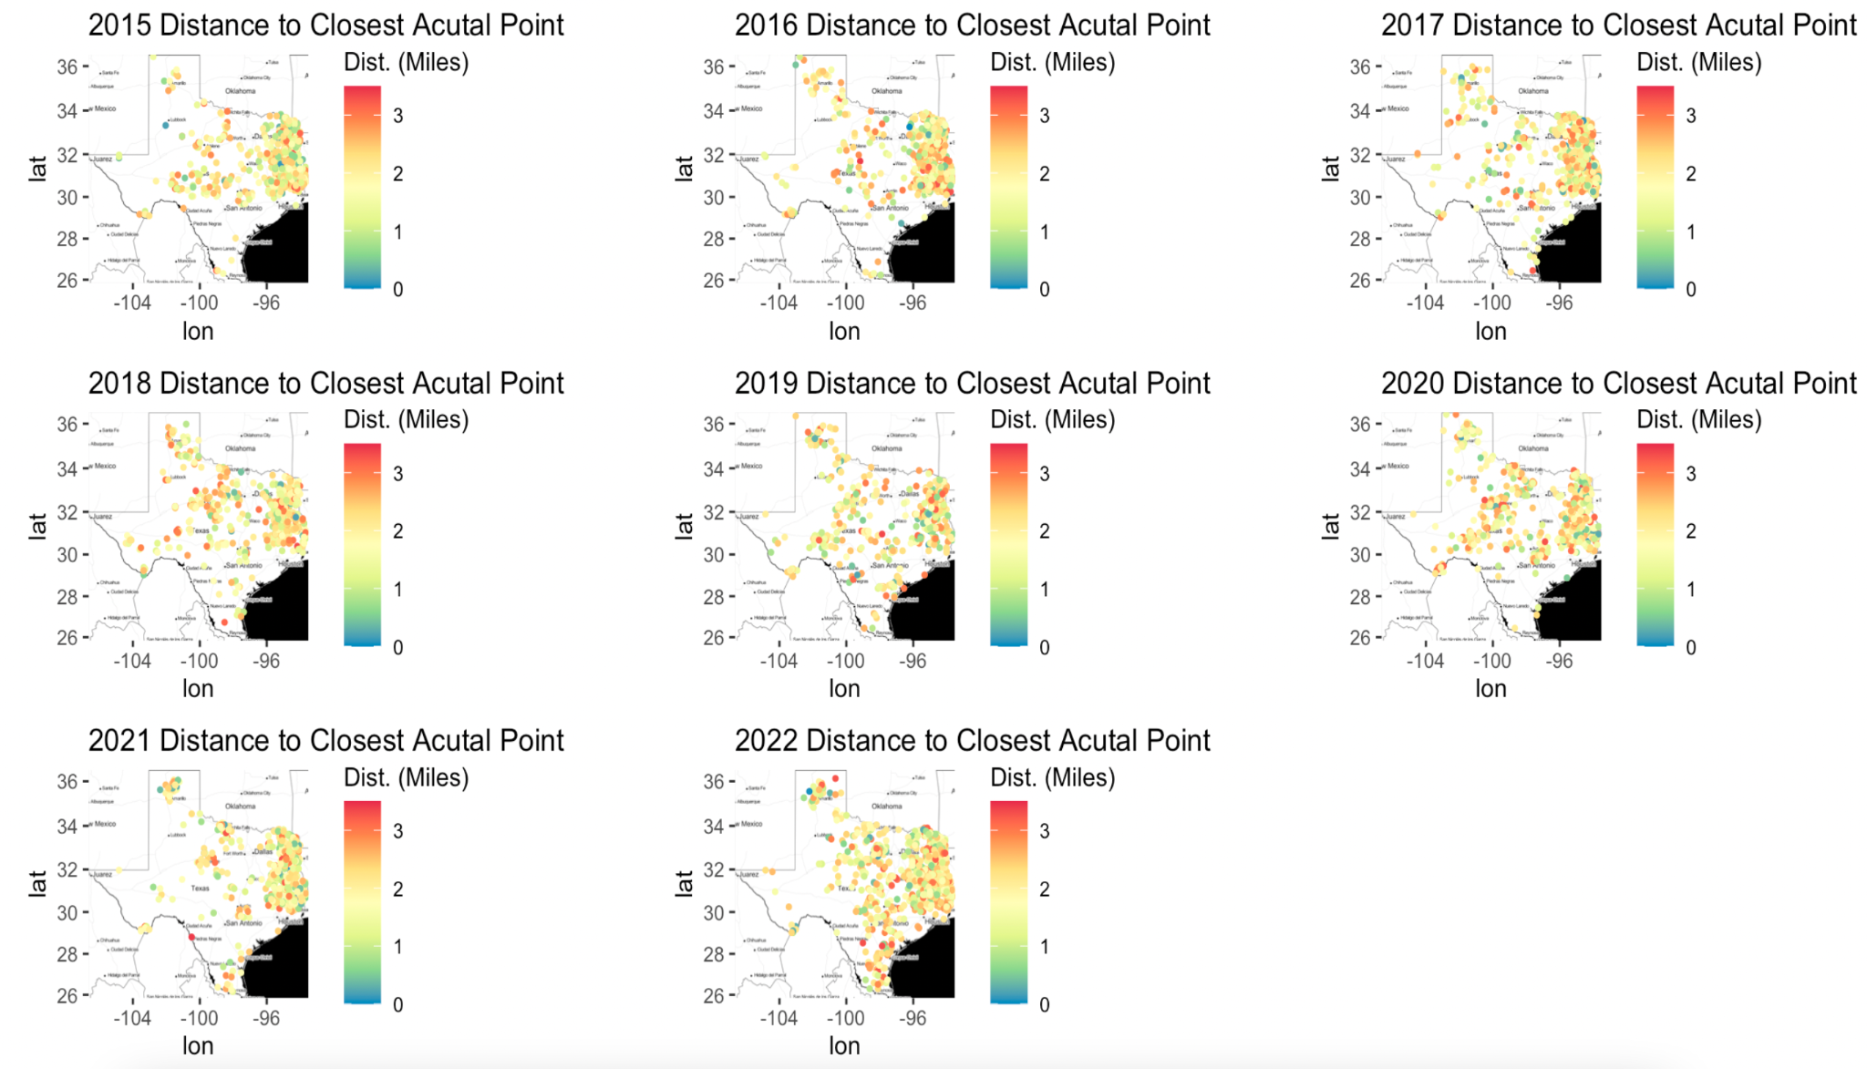

Slide 20
Conclusions for Second Model
It is clear that time (especially Years) has a massive impact on the severity of the Human and Natural caused wildfires in Texas (specifically 2018 spike). Monthly predictions showed what we would expect in terms of higher intensity during warmer months (April - August) and cooler intensity during colder months (1-3).
With the showing of standard error spread in the RPubs link we also see a spatial dependence visually towards East Texas in terms of minimized standard error in our predictions from the GAM model. The high density of points in that region consistently gave us our smallest error across all predictions no matter the year or month, (reference to RPubs last tab).So clearly spatial clusters will tend to have lower error compared to points in less populated areas that only contain singular points.
Time seems to have a more significant impact in our opinion in terms of the intensity of wildfires, clearly over the past 2-3 years it has come to a higher plateau, but the spike was clear and significant in 2018 for time and clearly in the western more desolate areas of Texas concerning causes by Humans and Nature.

Slide 21
Thank You

